Slide 1
Python lambda
Tien-Hsiung Weng

Slide 2
example
f = lambda x, y : x + y
>>> f(1,1)
2

Slide 3
map() Function
The advantage of the lambda operator can be seen when it is used in combination with the map() function.
map() is a function with two arguments:
r = map(func, seq)
def fahrenheit(T):
return ((float(9)/5)*T + 32)
def celsius(T):
return (float(5)/9)*(T-32)
temp = (36.5, 37, 37.5,39)
F = map(fahrenheit, temp)
C = map(celsius, F)

Slide 4
C = [39.2, 36.5, 37.3, 37.8]
F = map(lambda x: (float(9)/5)*x + 32, Celsius)
print F
[102.56, 97.700000000000003, 99.140000000000001, 100.03999999999999]
C = map(lambda x: (float(5)/9)*(x-32), F)
print C

Slide 5
a = [1,2,3,4]
b = [17,12,11,10]
c = [-1,-4,5,9]
map(lambda x,y:x+y, a,b)
[18, 14, 14, 14]
map(lambda x,y,z:x+y+z, a,b,c)
[17, 10, 19, 23]
map(lambda x,y,z:x+y-z, a,b,c)
[19, 18, 9, 5]

Slide 6
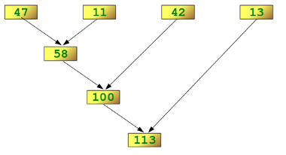
reduce(lambda x,y: x+y, [47,11,42,13])
113
f = lambda a,b: a if (a > b) else b
reduce(f, [47,11,42,102,13])
102

